Slide 1


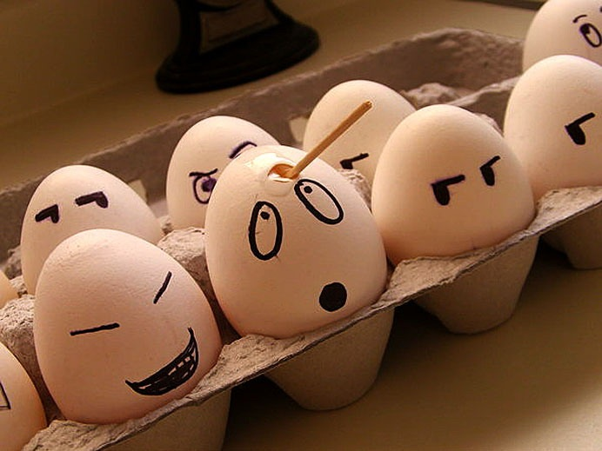

Generics
Java OOP
Advanced
SoftUni Team
Technical Trainers
Software University
http://softuni.bg

Slide 2

Table of Contents
What are Generics?
Generic Classes, Generic Interfaces, Generic Methods
Type Erasure, Type Parameter Bounds
Wildcards

Slide 3
Questions
sli.do #1066

Slide 4

What are Generics?
Notes:
Generics are also known as Parametrized types or Template types
Generics allow defining parameterized classes that process data of unknown (generic) type
The class is instantiated (specialized) with different particular types
Example: List<T> → List<int> / List<string> / List<DateTime> / List<Student>
Generics are known as "parameterized types" or "template types“
Commonly used for creation of different data structures.
Similar to the templates in C++
Similar to the generics in Java

Slide 5
What are Generics?
Generics allow defining parameterized classes

Slide 6
Example
public static void main(String[] args) { ArrayList<Integer> numbers = new ArrayList<Integer>(); }
Type Parameter
This is known as a Type Parameter
Notes:
In the example we are creating an array list of integers. It is as we are substituting the type parameter T with Integer.

Slide 7
What are Generics? (2)
Allow processing data of unknown (generic) type
Notes:
Generics allow container classes to be effectively decoupled from the concrete type they are storing. This makes it possible to create a template class that works with every possible type.

Slide 8
Generics Example
List<T> →

Slide 9
Generics Example (2)
List<Integer> / List<String> / List<Student>

Slide 10
Benefits of Generics
Provide more readable code
Notes:
The inclusion of <> makes the code to be self documenting, showing what a class is storing.

Slide 11
Benefits of Generics (2)
Generics add type safety
Notes:
Generics add compile time type safety, which means that the programmer is protected from making some obvious mistakes like inserting incompatible type in a collection. This is done compile time, which means that this process if free in runtime.

Slide 12

Generic Classes

Slide 13
Generic Classes
Mostly used as containers
Notes:
Generic classes are mostly used to create containers which can store unspecified types.

Slide 14
Example
T is an unknown type, parameter of the class
public class GenericList<T> { public void Add(T element) { … } }
T can be used in any method in the class

Slide 15
Example (2)
static void Main() { // Declare a list of type int GenericList<Integer> intList =
new GenericList<Integer>(); // Declare a list of type string GenericList<String> stringList =
new GenericList<String>(); }
T is replaced with int during the instantiation
T is replaced with string during the instantiation

Slide 16

Conventions

Slide 17
Example
Type parameters are defined using a single capital letter
public class GenericList<T> { public void Add(T element) { … } }
T is abbreviation from Type

Slide 18

Demo

Slide 19

Exercises in Class

Slide 20

Generic Interfaces

Slide 21
Generic Interfaces
Generic Interfaces add flexibility
Notes:
Using a generified interfaces broaden the scope in which we can use them.

Slide 22

Generic Methods

Slide 23
Generic Methods
Can take generic input and return generic output

Slide 24
Example
public static <T> List<T> createList (T value, int count) { List<T> genericList = new ArrayList<>(); for (int i = 0; i < count; i++) { genericList.add(value); } return genericList; }

Slide 25
Demo

Slide 26
Exercises in Class

Slide 27

Generics In Java

Slide 28
Generics in Java
Type Erasure
Notes:
Type erasure basically means that information about type parameters is lost during runtime. This causes some problems as not being able to use T for creation of objects, arrays or checking if it is instance of some concrete type. Most of those have a workaround which is not so straightforward.

Slide 29
Generics in Java (2)
Type Parameter Bounds
Notes:
Type parameter bounds are bounds on the type parameter which tells us its upper or lower bound. Bounds are created using the extends keyword.

Slide 30
Bounds Example
Bounds are created by the extends keyword
public <T extends Comparable<T>> T min(T first, T second) { if (first.compareTo(second) <= 0) { return first; } else { return second; } }

Slide 31
Wildcards
Allow covariance and contravariance
Notes:
Wildcards provide a simpler way of

Slide 32
Wildcards Example
T is replaced with ?
public static void feed(List<? extends Animal> animals) { for (Animal animal : animals) { animal.feed(); } }

Slide 33
Wildcards Example (2)
public static <T extends Cat> void addCatToList(
List<? super T> list, T item) { list.add(item); }

Slide 34

Summary
Generics are parameterized classes
Template classes for processing data of unknown (generic) type
Generic methods can accept generic parameter types
Generic interfaces allow defining flexible contracts
Java Generics Specifics
Type Parameters, Bounds and Wildcards

Slide 35








OOP Advanced – Generics
httpshttps://softuni.bg/courses/oop/

Slide 36

License
This course (slides, examples, demos, videos, homework, etc.) is licensed under the "Creative Commons Attribution-NonCommercial-ShareAlike 4.0 International" license
Attribution: this work may contain portions from
"Fundamentals of Computer Programming with Java" book by Svetlin Nakov & Co. under CC-BY-SA license
" Thinking in Java 4th ed." book by Bruce Eckel, Copyright © 2006 by Bruce Eckel
"OOP" course by Telerik Academy under CC-BY-NC-SA license

Slide 37






Free Trainings @ Software University
Software University Foundation – softuni.org
Software University – High-Quality Education, Profession and Job for Software Developers
softuni.bg
Software University @ Facebook
facebook.com/SoftwareUniversity
Software University @ YouTube
youtube.com/SoftwareUniversity
Software University Forums – forum.softuni.bg

